Slide 1

Cyber Security
TY IT-1, BATCH C
KAUSTUBH WADE 160410116050
NAISARGI KOTHARI 160410116051
KARANSINH MATROJA 160410116055
JEET MEGHPARA 160410116056

Slide 2
What is Cyber Security?
Cyber Security is the protection of computer systems from theft or damage to their hardware, software or electronic data, as well as from disruption or misdirection of the services they provide.
The field is of growing importance due to increasing reliance on computer systems, the Internet and wireless networks such as Bluetooth and Wi-Fi, and due to the growth of "smart" devices, including smartphones, televisions and the various tiny devices that constitute the Internet of Things. Due to its complexity, both in terms of politics and technology, it is also one of the major challenges of contemporary world.

Slide 3
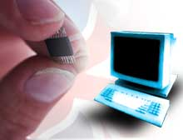
What is Cyberspace?
Cyberspace is a worldwide network of computers and the equipment that connects them, which by its very design is free and open to the public (the Internet)
We've become increasingly reliant on the net, and it's being used right now to transfer everything from friendly emails to hypersensitive data.

Slide 4
What kind of attacks are we talking about?
The attackers are mostly malicious pranksters, looking to access personal and business machines or disrupt net service with virus programs proliferated via email, usually just to prove they can.
However, there are also more serious attackers out there whose goals could range from mining valuable data (your credit card or bank information, design secrets, research secrets, etc) to even disrupting critical systems like the stock market, power grids, air-traffic controllers programs, and the most dangerous-our nuclear weapons.

Slide 5
What are the Threats?
A threat, in the context of computer security, refers to anything that has the potential to cause serious harm to a computer system.
At this point it is difficult to quantify since computer intrusions occur daily originating from several sources. The origination of these intrusions and the intent of the intruders is often not obvious.
These threats come in the form of:
Computer Intrusion (hacking-passive or active)
Denial of service attacks (DOS)
Virus & Worms deployment.

Slide 6
Cyber Security Risks
The British security consulting firm mi2g calculates that the number of malicious hacking attacks worldwide jumped from about 8,000 in 2000 to 31,000 in 2001, and projects attacks to exceed 60,000 in 2004.

Slide 7
Denial of Service Attacks
In a denial of service attack, a hacker compromises a system and uses that system to attack the target computer, flooding it with more requests for services than the target can handle. In a distributed denial of service attack, hundreds of computers (known as a zombies) are compromised, loaded with DOS attack software and then remotely activated by the hacker.

Slide 8
Security
“Security” is the quality or state of being secure--to be free from danger. But what are the types of security we have to be concern with?
Physical security - addresses the issues necessary to protect the physical items, objects or areas of an organization from unauthorized access and misuse.
Personal security - addresses the protection of the individual or group of individuals who are authorized to access the organization and its operations.
Operations security- protection of the details of a particular operation or series of activities.

Slide 9
The problem that we cannot get away from in computer security is that we can only have good security if everyone understands what security means, and agrees with the need for security.
Security is a social problem, because it has no meaning until a person defines what it means to them.
The harsh reality is the following: In practice, most users have little or no understanding of security. This is our biggest security hole.

Slide 10
Access vs. Security
When considering security it is important to realize that it is impossible to obtain perfect security. Security is not an absolute. Instead security should be considered a balance between protection and availability.
It is possible to have unrestricted access to a system, so that the system is available to anyone, anywhere, anytime, through any means. However, this kind of random access poses a danger to the integrity of information.
On the other hand complete security of an information system would not allow anyone access at any given time.

Slide 11
Balancing Security and Access- Too much security might make access hard to get and people will stop using the system. On the other hand, a too easy access protocol, might be a security hole for the network. A balance must be achieved between those two major “players”

Slide 12
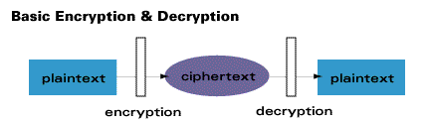
Encryption
The root of the word encryption—crypt—comes from the Greek word kryptos, meaning hidden or secret.
Encryption is the process of converting messages, information, or data into a form unreadable by anyone except the intended recipient. As shown in the figure below, Encrypted data must be deciphered, or decrypted, before it can be read by the recipient.

Slide 13
Modern Encryption Algorithms
Private Key Encryption
Public Key Encryption
Quantum Cryptography

Slide 14
Private Key Algorithms
Private key encryption algorithms use a single key for both encryption and decryption. In order to communicate using this class of ciphers, the key must be known to both sender and receiver of the message.

Slide 15
Public Key Algorithms
Public key methods require two unique keys per user; one called the public key, and the other called the private key.
The private key is mathematically linked to the public key. While public keys are published, private keys are never exchanged and always kept secret.

Slide 16
Quantum Cryptography
Method of secure key exchange over an insecure channel based on the nature of photons
Polarized photons are transmitted between sender and receiver to create a random string of numbers, the quantum cryptographic key

Slide 17
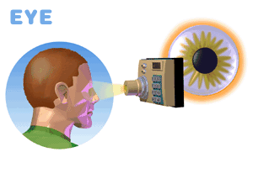
Biometrics Devices
The iris of your eye is the colored part that surrounds your black pupil, the black part. Every iris is different. If a scan of a user’s iris matches the one in the security system’s memory, access is allowed.

Slide 18
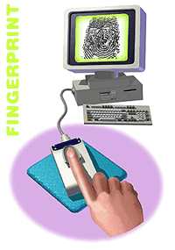
Biometrics Devices
Another biometric option is the fingerprint and its unique identifying characteristics. Placed on a special reading pad, a designated finger’s print is recognized by a computer. A similar biometric device scans a person’s whole hand

Slide 19
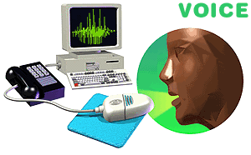
Biometrics Devices
Another trait unique to every individual is his or her voice. The user speaks a specified word or sentence to gain access to a secured computer. Distinct patterns, tones, and other qualities in the voice must match the authorized user’s voice in the computer’s security system.

Slide 20
THANK YOU!

